Slide 1


VACCINATION SLOT FINDER
Presented by:
Sai Manoj Cheruvu (18311A19G6)
Manideep Mokurala (18311A19F1)
Faculty mentor:
Dr.ameet chauan

Slide 2
AGENDA
Problem Statement
Solution
Setu API
Understanding sample data
Using Setu API in python

Slide 3
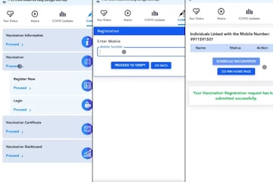
Problem statement
It has been a tough covid time and finding a vaccination center has been difficult
The arogya setu app/Cowin website repeatedly prompts for OTP verification and doesn’t return accurate results a times

Slide 4
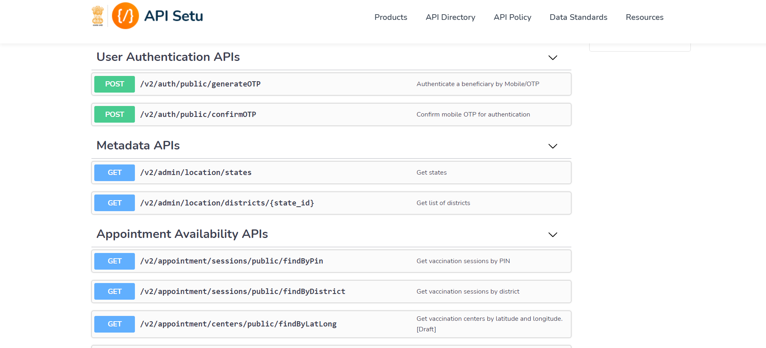
SETU API
This is the data provided by the government that is open to public.
We can get data on the basis of state names, district names, pin codes etc

Slide 5
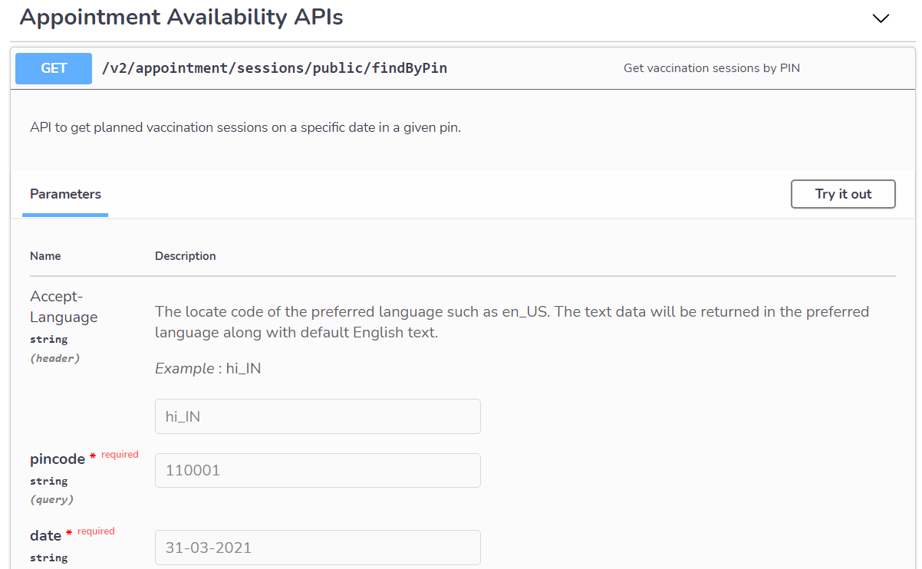
SETU API Sample Data
In this case we are going to use the pin code and date
Step 1: This is how it looks like when we use get by pin API

Slide 6
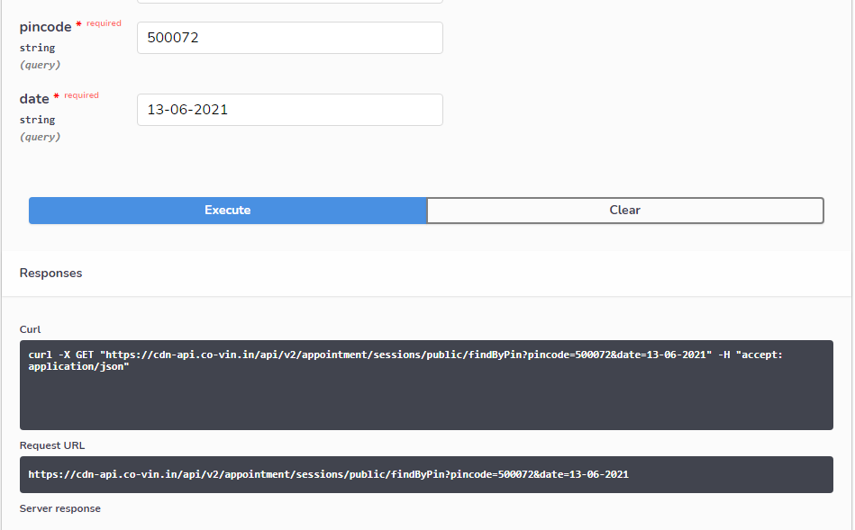
SETU API SAMPLE DATA
Step 2: Give an example pin code

Slide 7
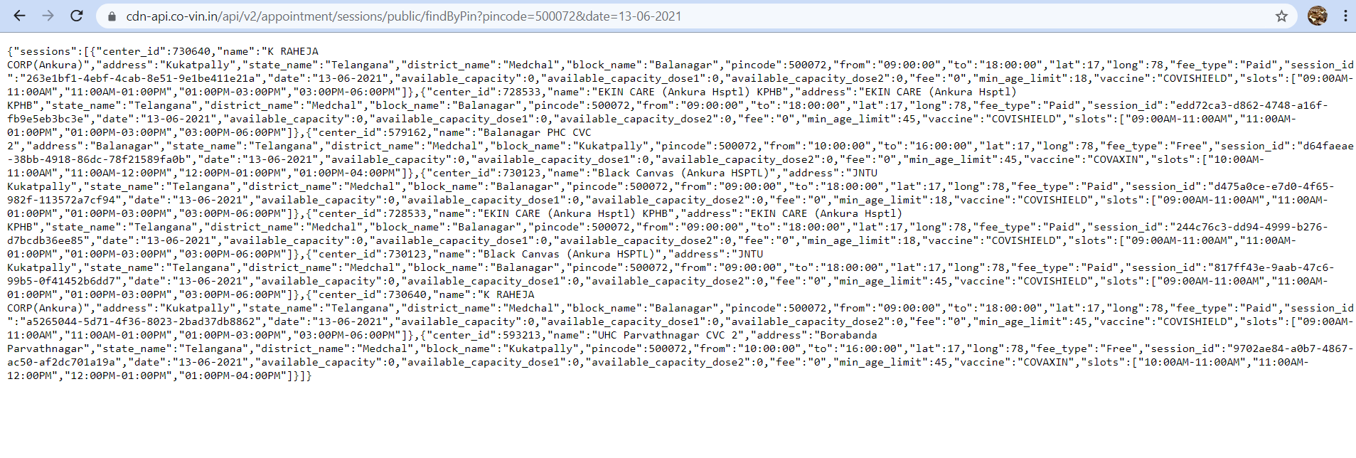
SETU API SAMPLE DATA
Step 3: Copy and paste the link it gave in a new tab

Slide 8
Python code Explanation
From Python we use requests module to connect with python
We retrieve the data from Setu API
When observed the setu API has returned data in the form of JSON which has key as “Sessions”
So using the Key “Session” we are going to retrieve the values that is the details of the vaccinations centers as a list
We are going to iterate through the list and return them in a prettier way

